Slide 1
Employee Attrition Analysis

Slide 2


Data Analyst
INTERNSHIP DONE UNDER
Presented By :- Akshay Hosurkar

Slide 3
Details Of The Dataset
Employee ID, age, separation status, business trip frequency, department, distance from home, education level, field of study, number of employees, gender, rank, job, marital status, monthly income, number of companies changed, age 18 or older, annual salary Raise rate, standard hours, stock option level, total years of service, number of trainings last year, years with the company, years since last promotion, years of service with current manager, environmental satisfaction, job satisfaction, work-life balance, job involvement, performance evaluation

Slide 4
Overview of Employee Data
Total Employees: 4,410
Attrition Rate: 16.12%
Average Salary: $65.03K
Average Performance Rating: 3.15
Average Salary Hike: 15.21%

Slide 5
Attrition by Job Role
Highest Attrition : Research Director: 23.75%Research Scientist: 18.15%
Roles with Moderate Attrition : Sales Executive, Lab Technician,
Manager: 16.22% - 16.87%
Roles with Lower Attrition : HR and Manufacturing Directors: ~13%

Slide 6
Attrition by Marital Status
Single Employees: 53.08%
Other Statuses : Married: 25.95%
Divorced: 20.98%
Attrition by Business Travel
Frequent Travelers: 24.91% attrition rate
Rare Travelers: 14.96% attrition rate
Non-Travelers: 8% attrition rate

Slide 7
Attrition by Environment Satisfaction
Level 1 Satisfaction (Lowest): 25.21% attrition rate
Level 2 Satisfaction: 20%
Level 4 Satisfaction (Highest): 13.42%

Slide 8
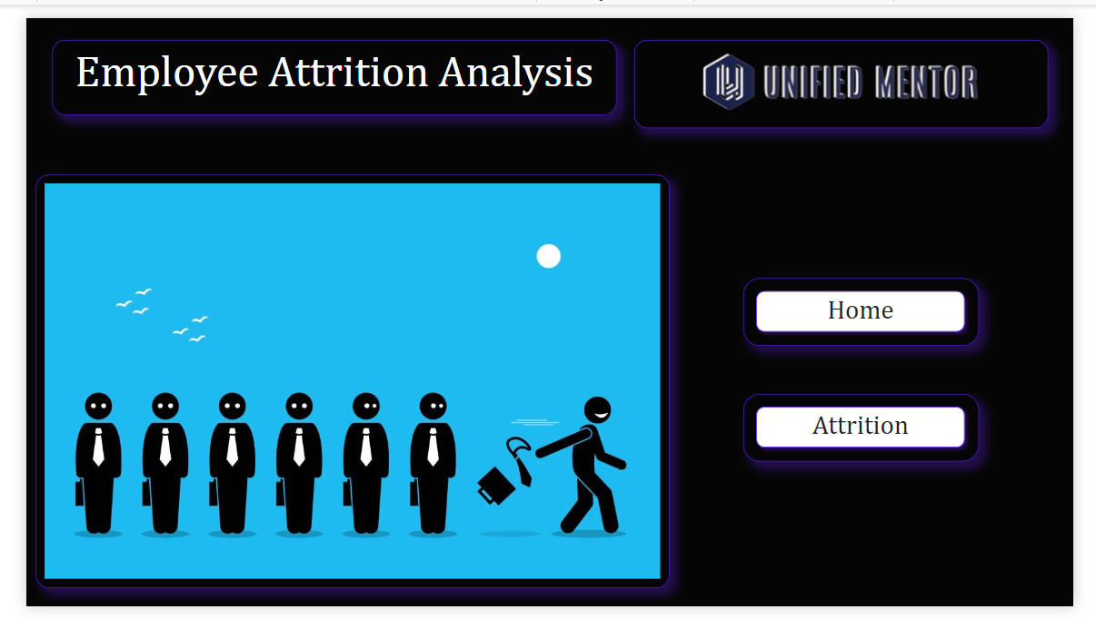
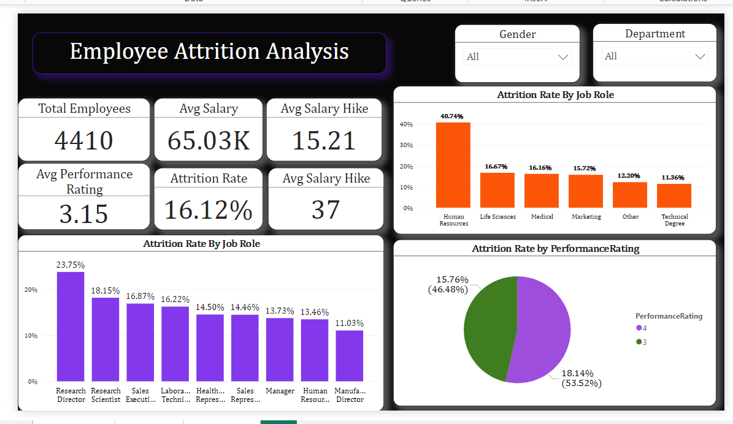
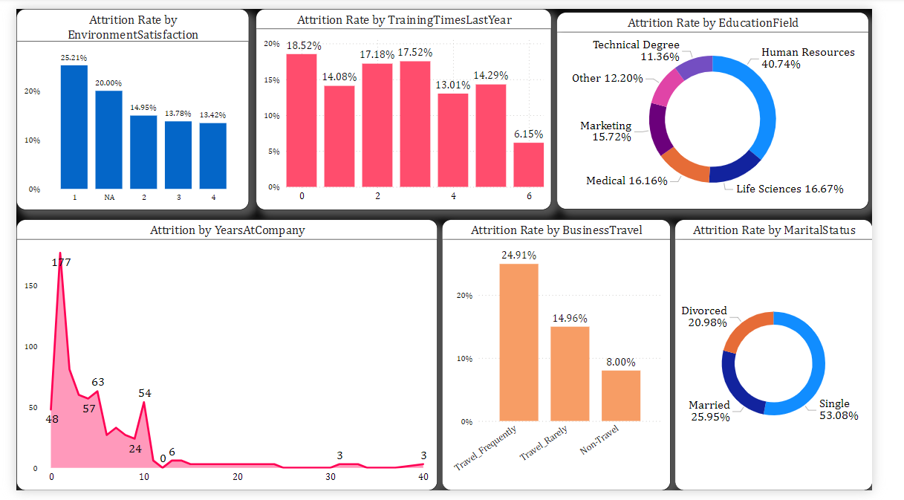
Mock Up Design
Home
Attrition

Slide 9

THANK YOU

